Slide 1
WEB DESIGNING
STEPS TO USE GITHUB

Slide 2
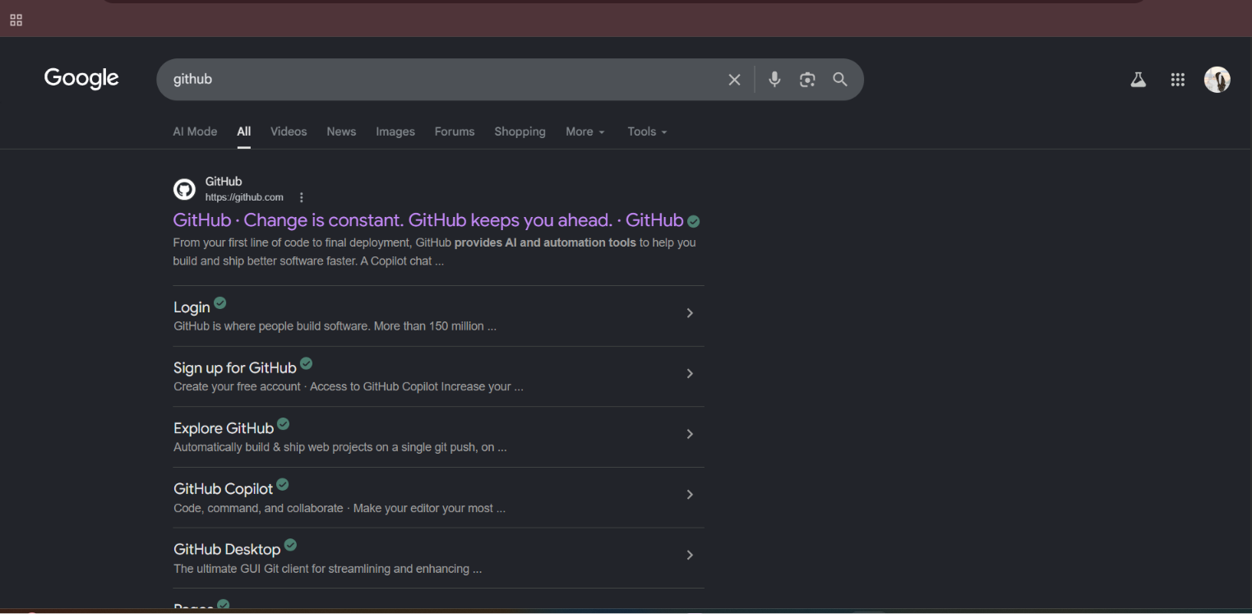

STEP 1:Go to chrome (or) FirEfox and open GitHub website.

Slide 3
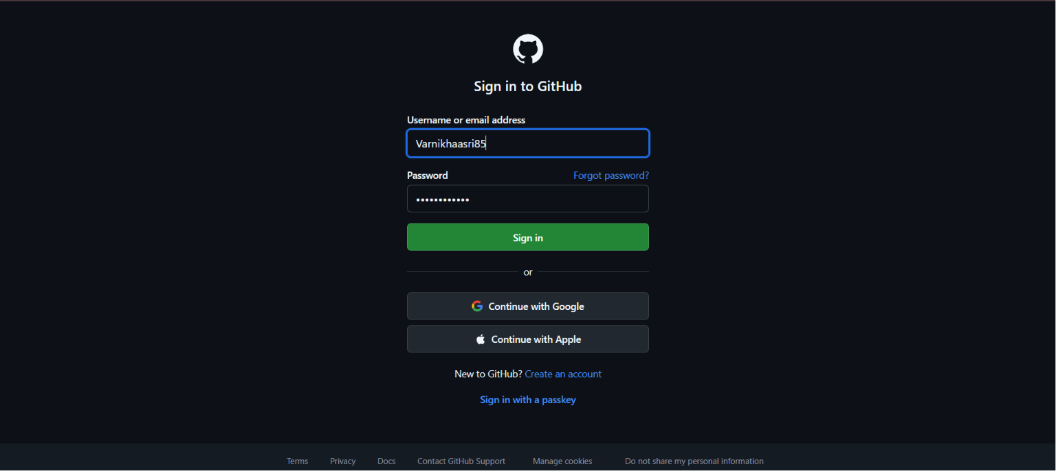
STEP 2:LOGIN IN GITHUBWITH YOUR USER NAME OR EMAIL ID AND PASSWORD.IF YOUR NEW FOR GITHUB CREATE AN ACCOUNT.

Slide 4
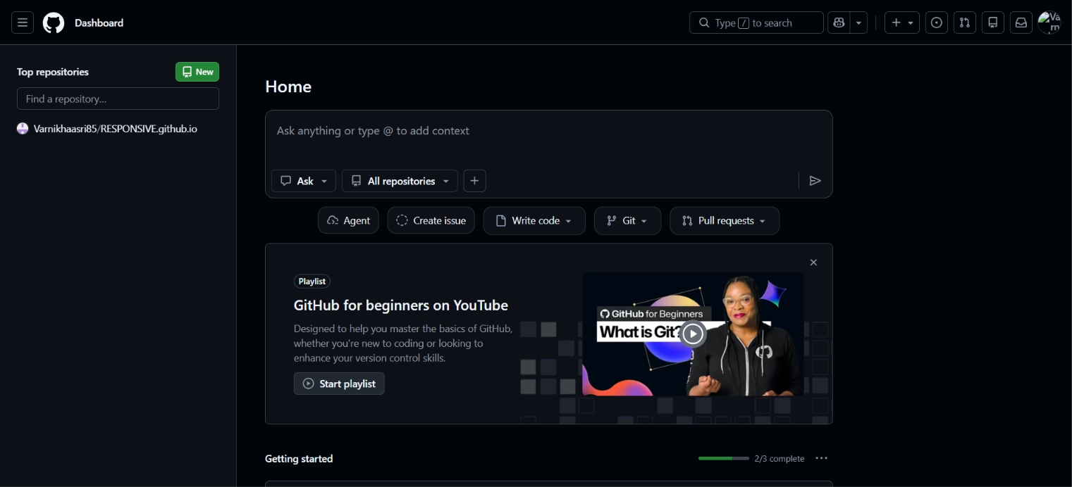
STEP 3:CLICK THE NEW REPOSITAR OR NEW BUTTON.

Slide 5
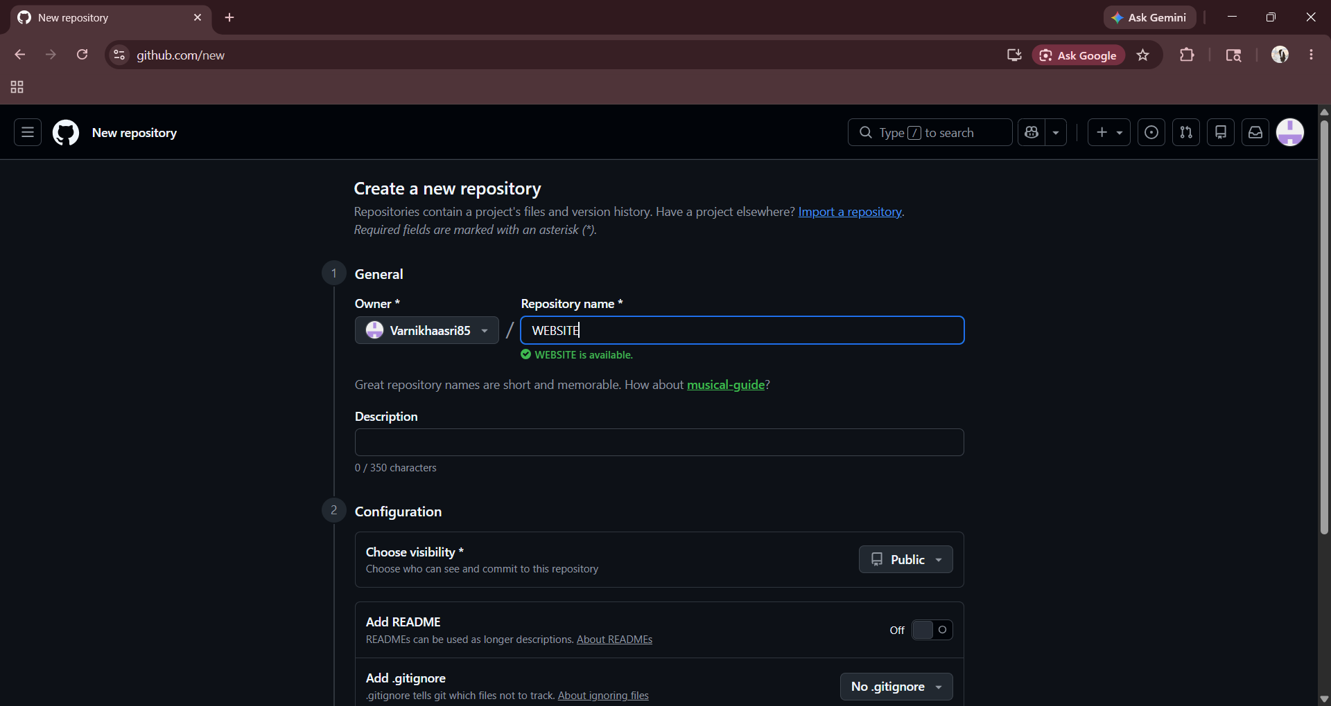
STEP 4:ENTER THE REPOSITORY NAME.

Slide 6
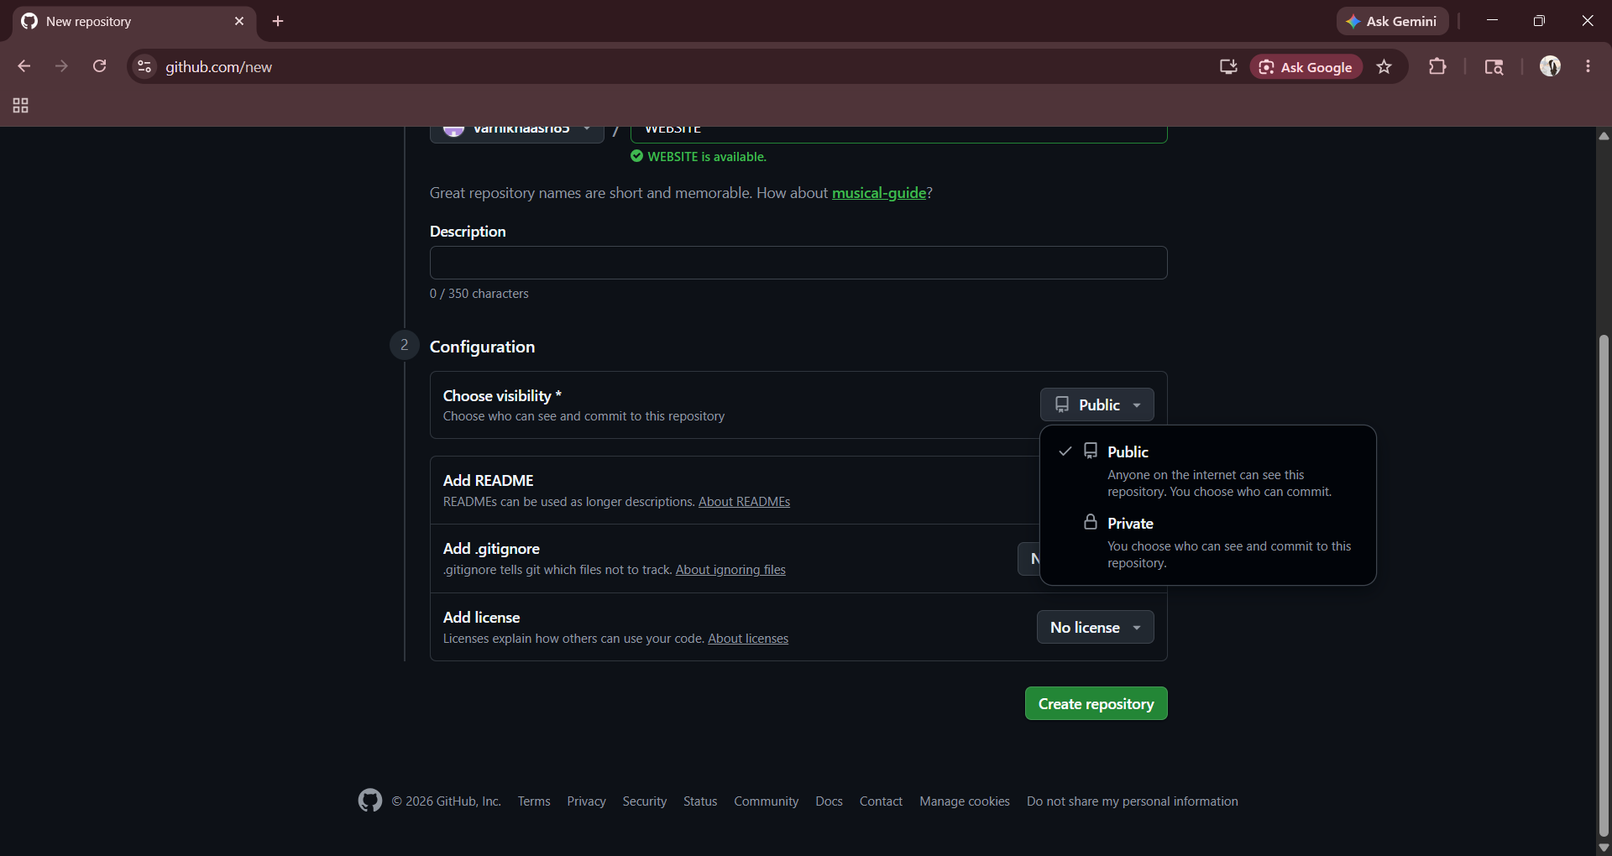
STEP 5:CLICK CONFIGURATION-->CHOOSE VISIBILITY->PUBLIC
AND CLICK CREATE RESPOSITORY.

Slide 7
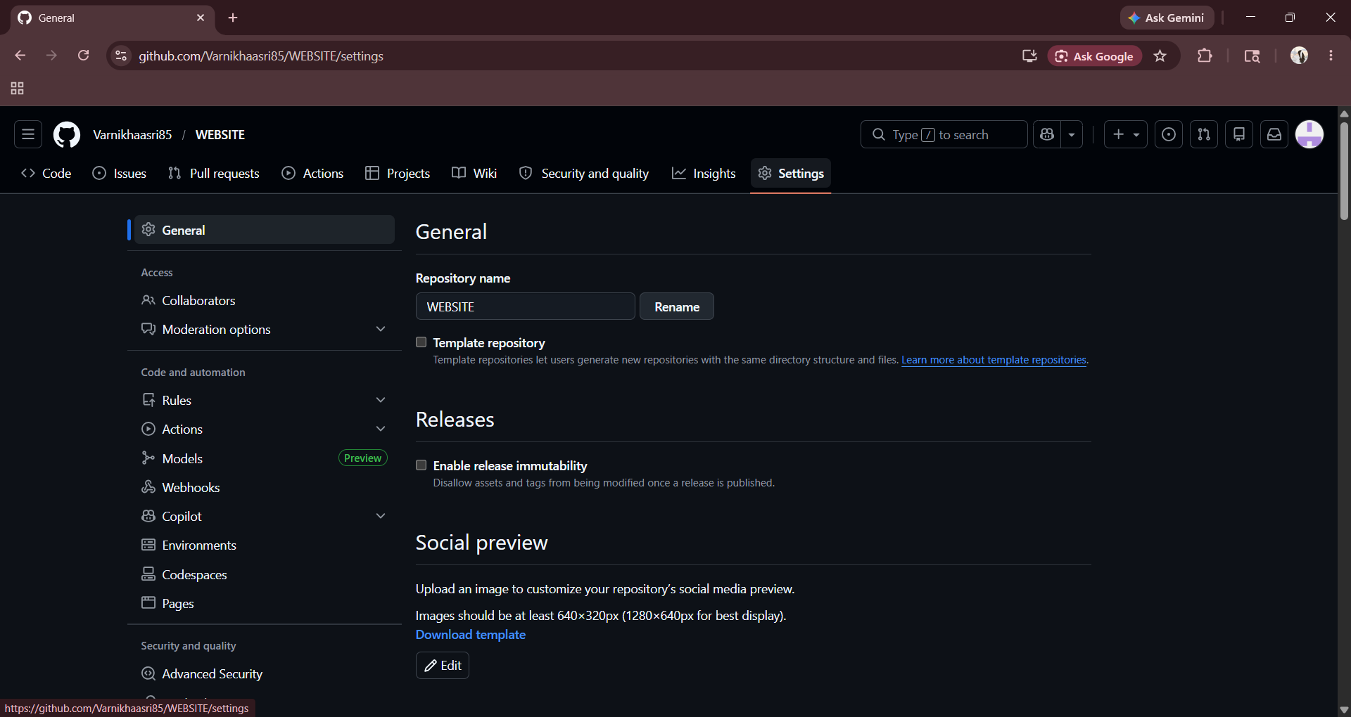
STEP 6:CLICK SETTINGS

Slide 8
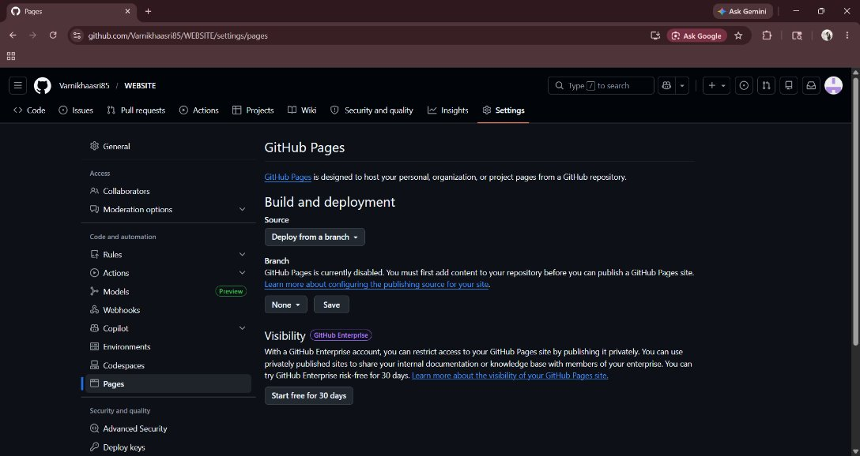
STEP 7:CLICK PAGES.

Slide 9
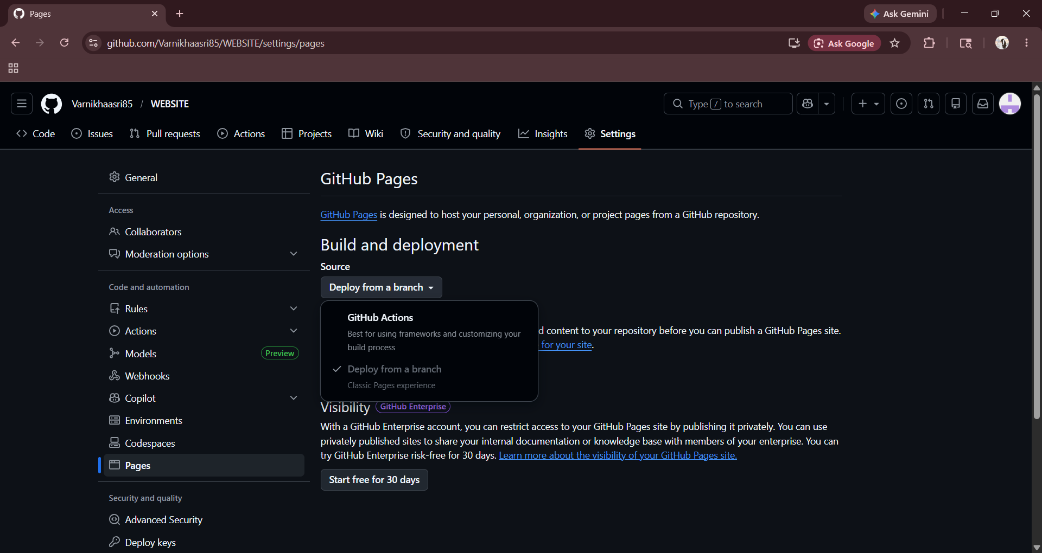
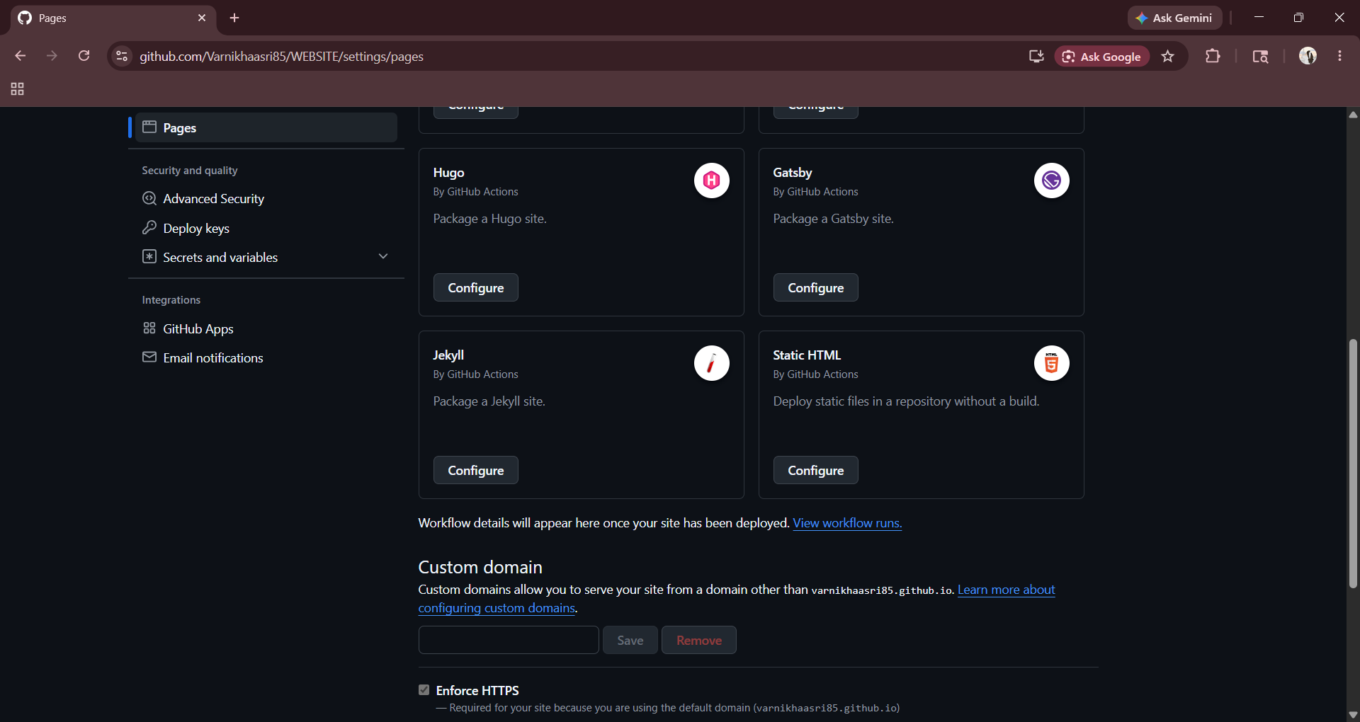
STEP 8:CLICK GITHUB ACTIONS THENSELECT STATIC HTML AND CLICK CONFIGURE.

Slide 10
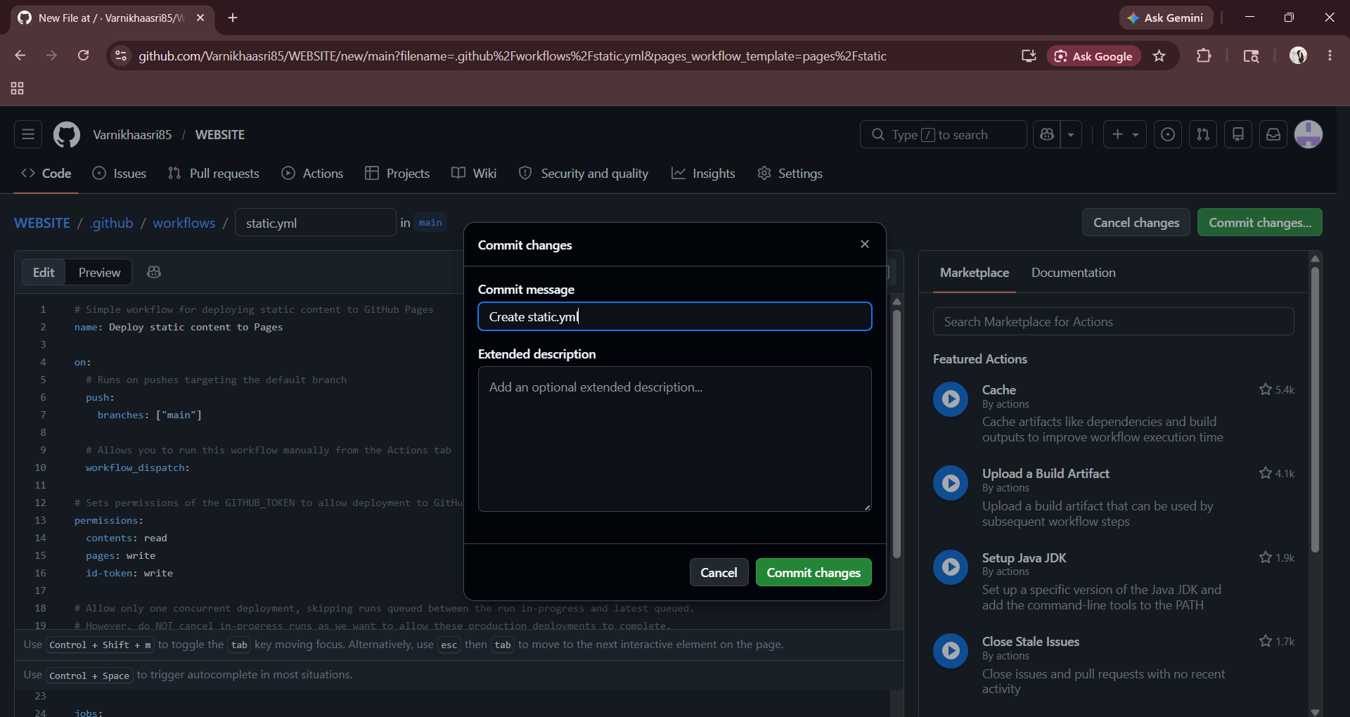
STEP 9:CLICK COMMIT CHANGE AND CLICK OK.

Slide 11
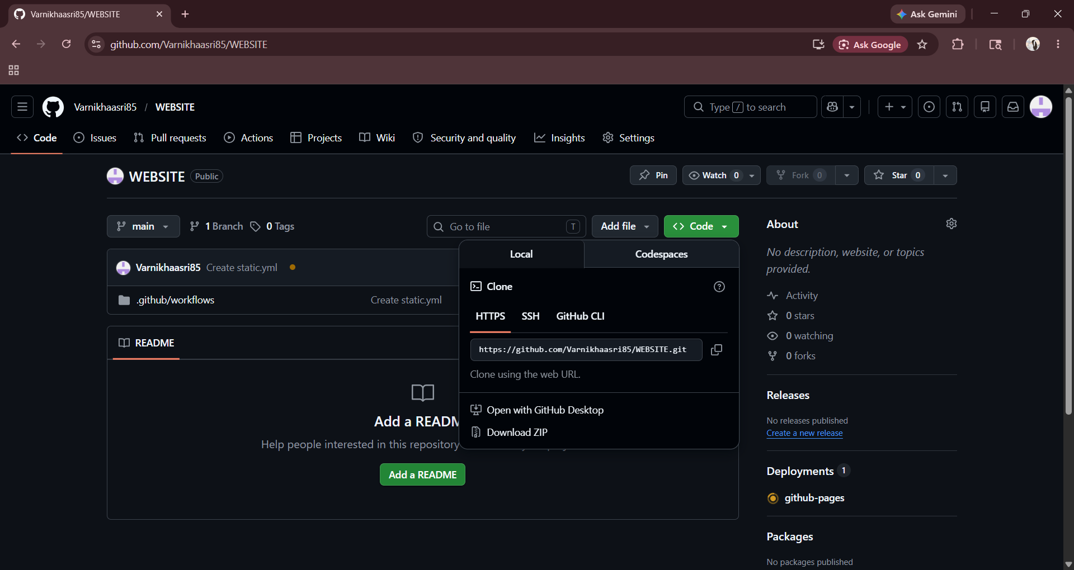
STEP 10:CLICK CODE-->AGAIN CLICK CODE-->OPEN WITH GITHUB DESKTOP.

Slide 12
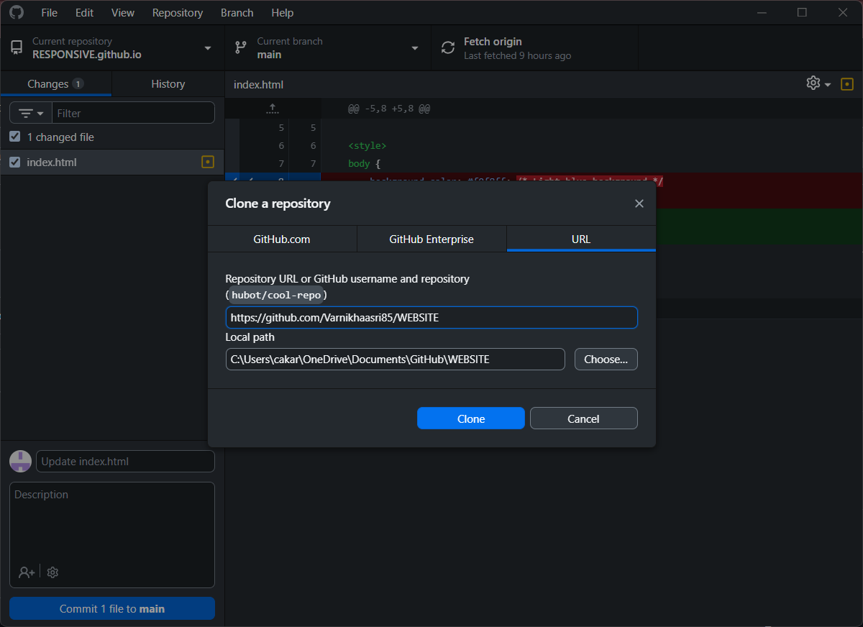
STEP 11:CLICK CLONE OPTION.

Slide 13
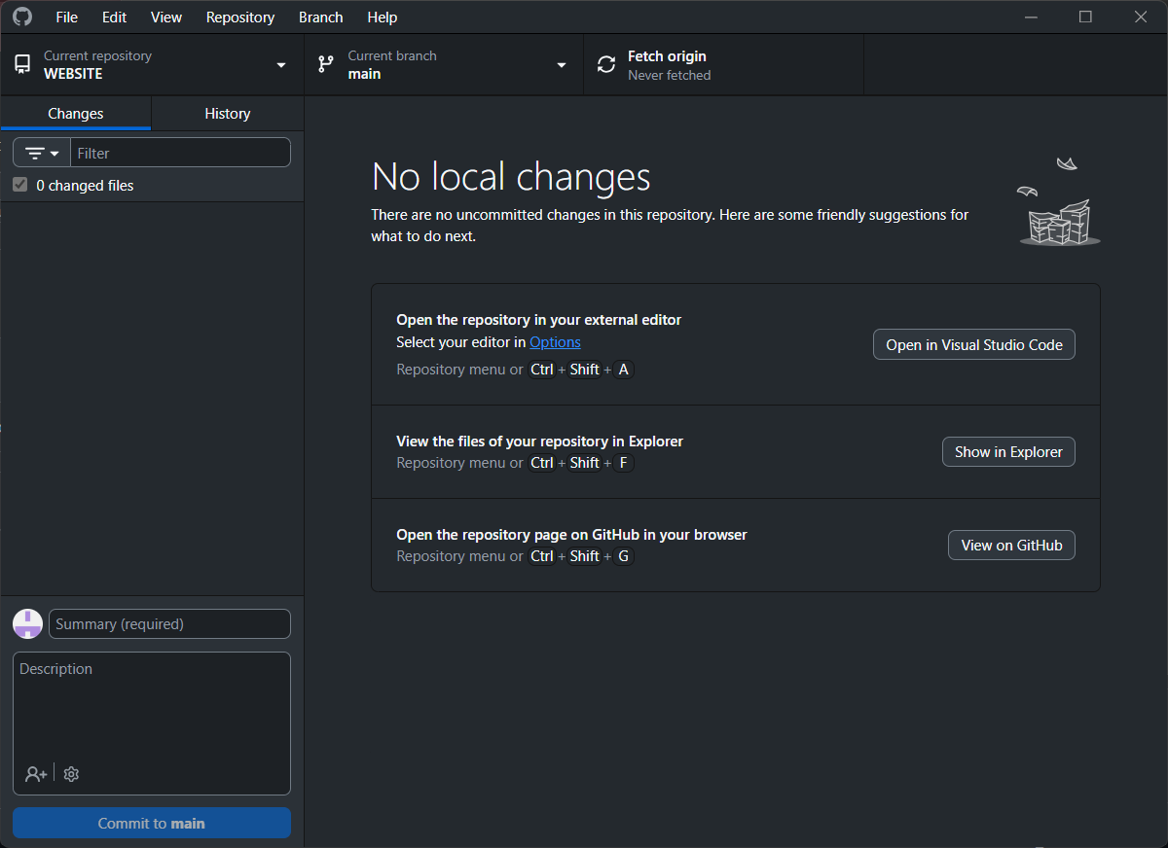
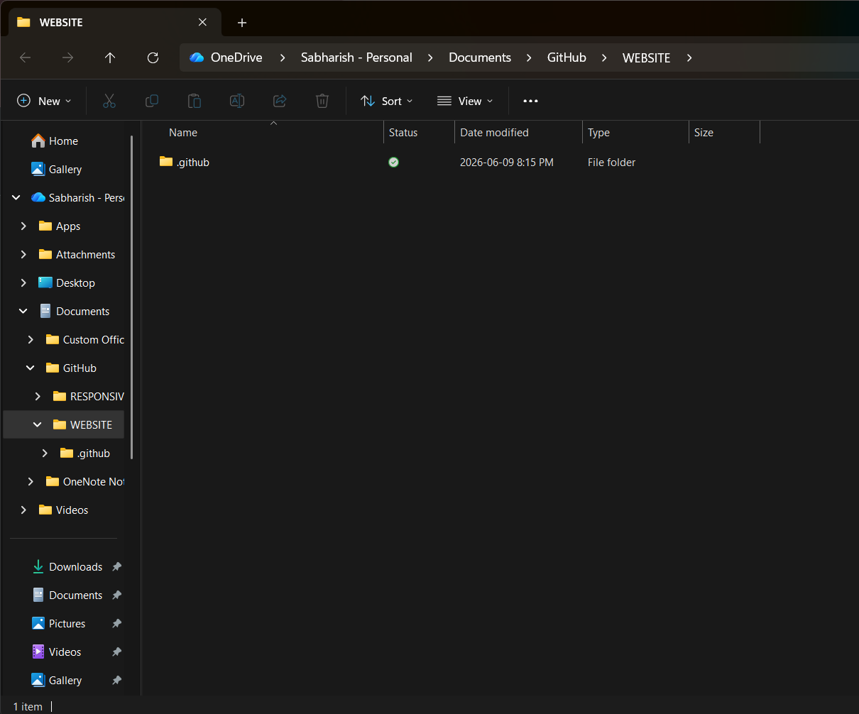
STEP 12:CLICK SHOWN IN EXPLOER.

Slide 14
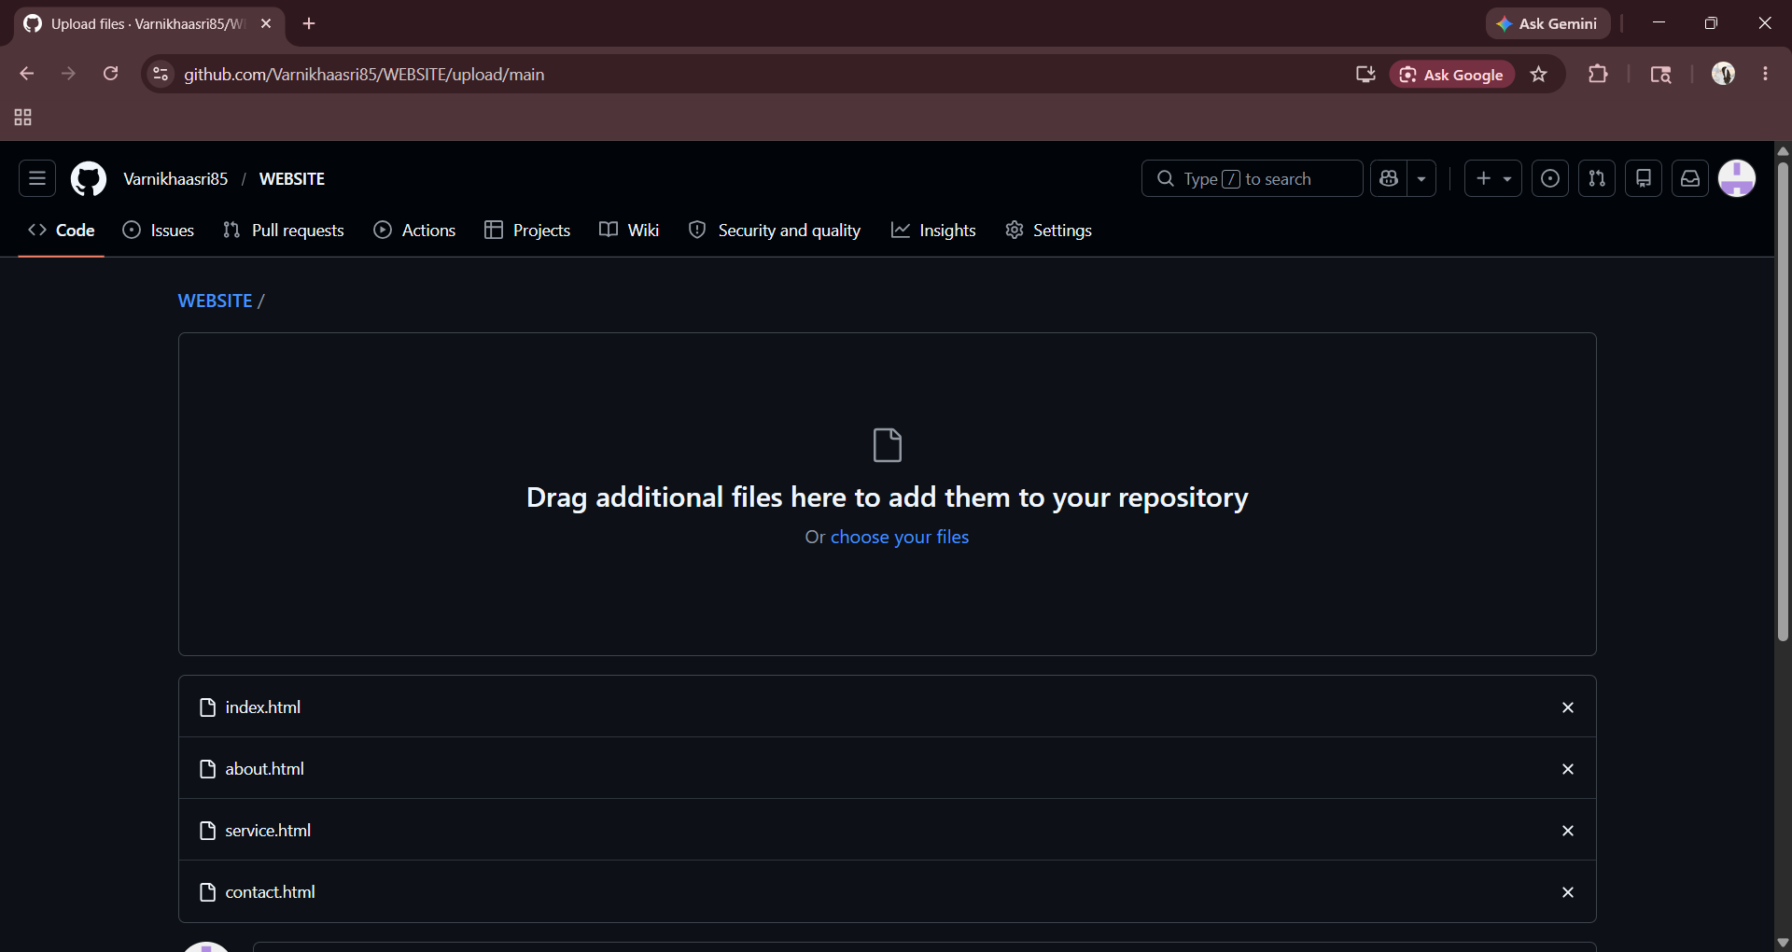
STEP 12:GO TO GITHUB AND AND CLICK THE REPOSITARY
AND ADD THE FILES MADE IN VISUAL STUDIO CODE.

Slide 15
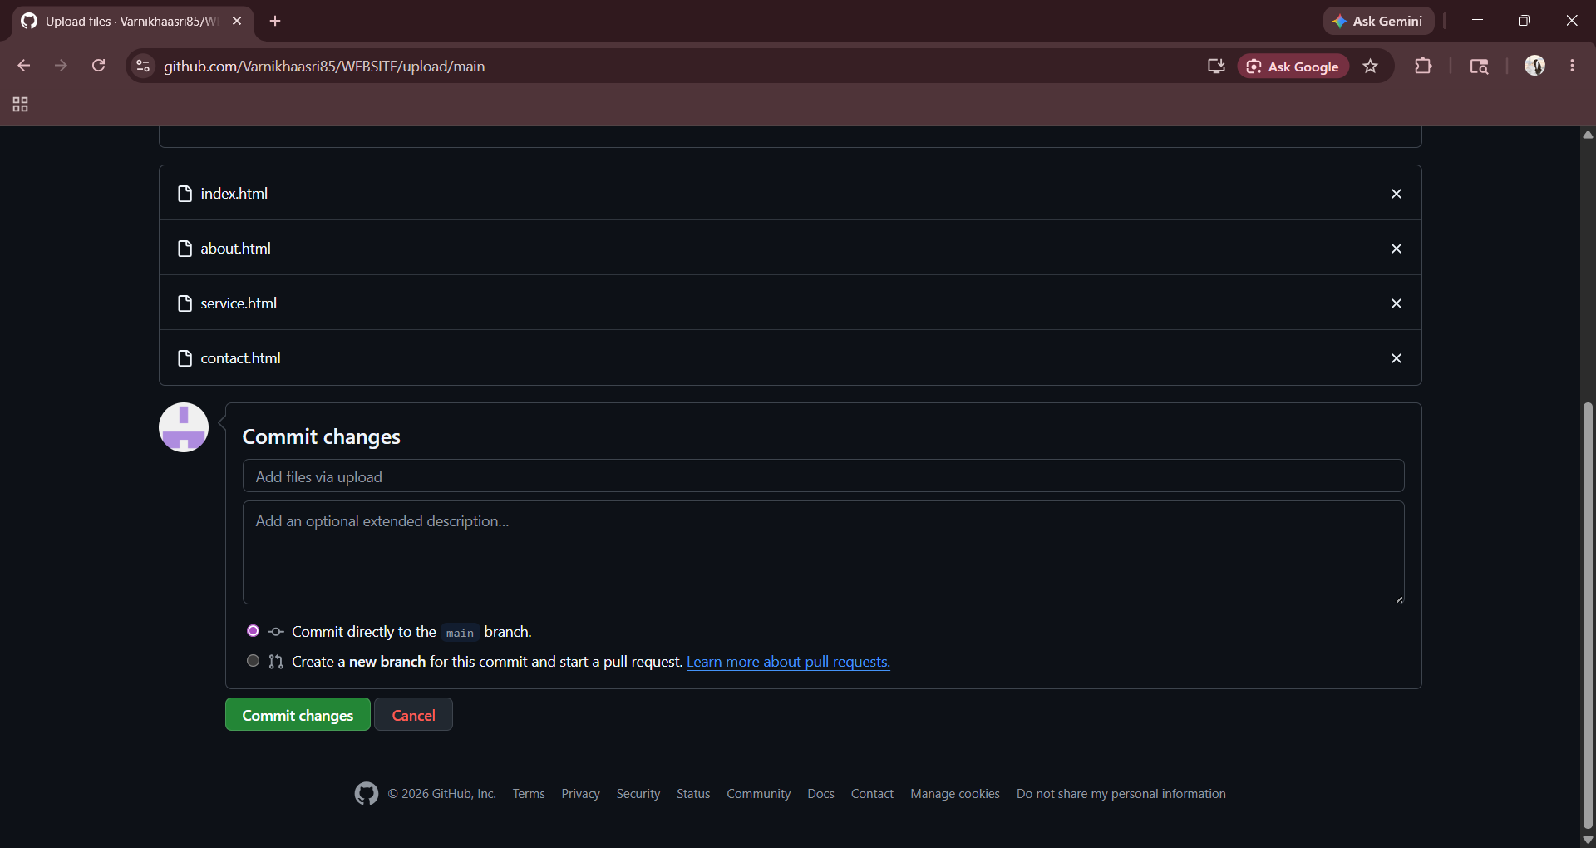
STEP 13:CLICK COMMIT CHANGES.

Slide 16
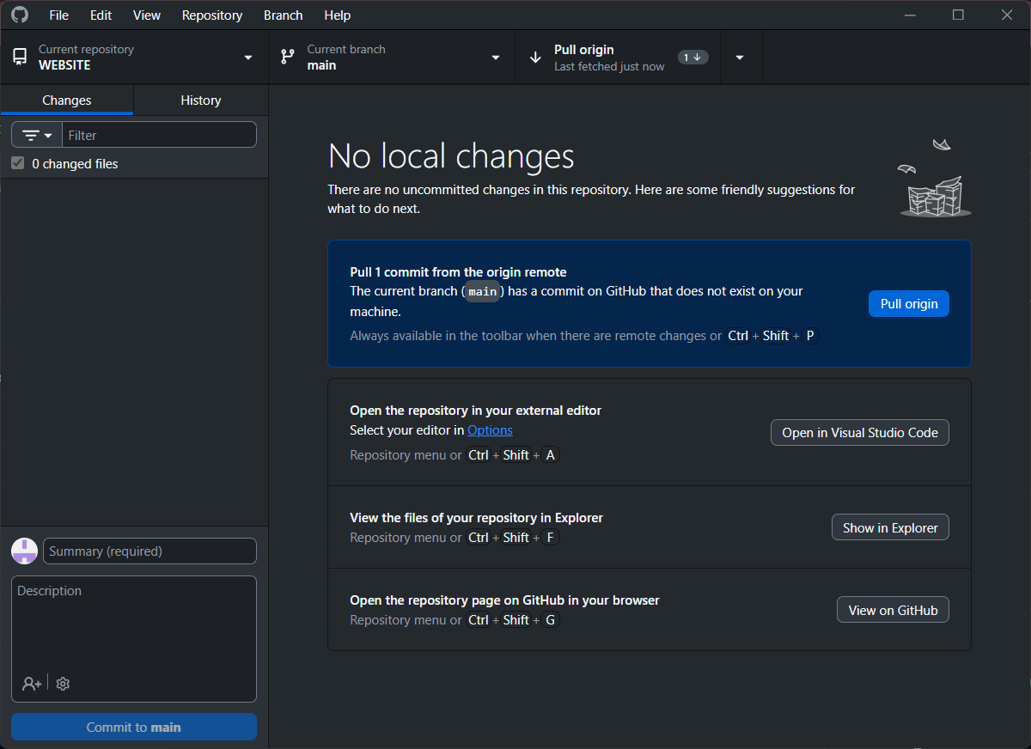
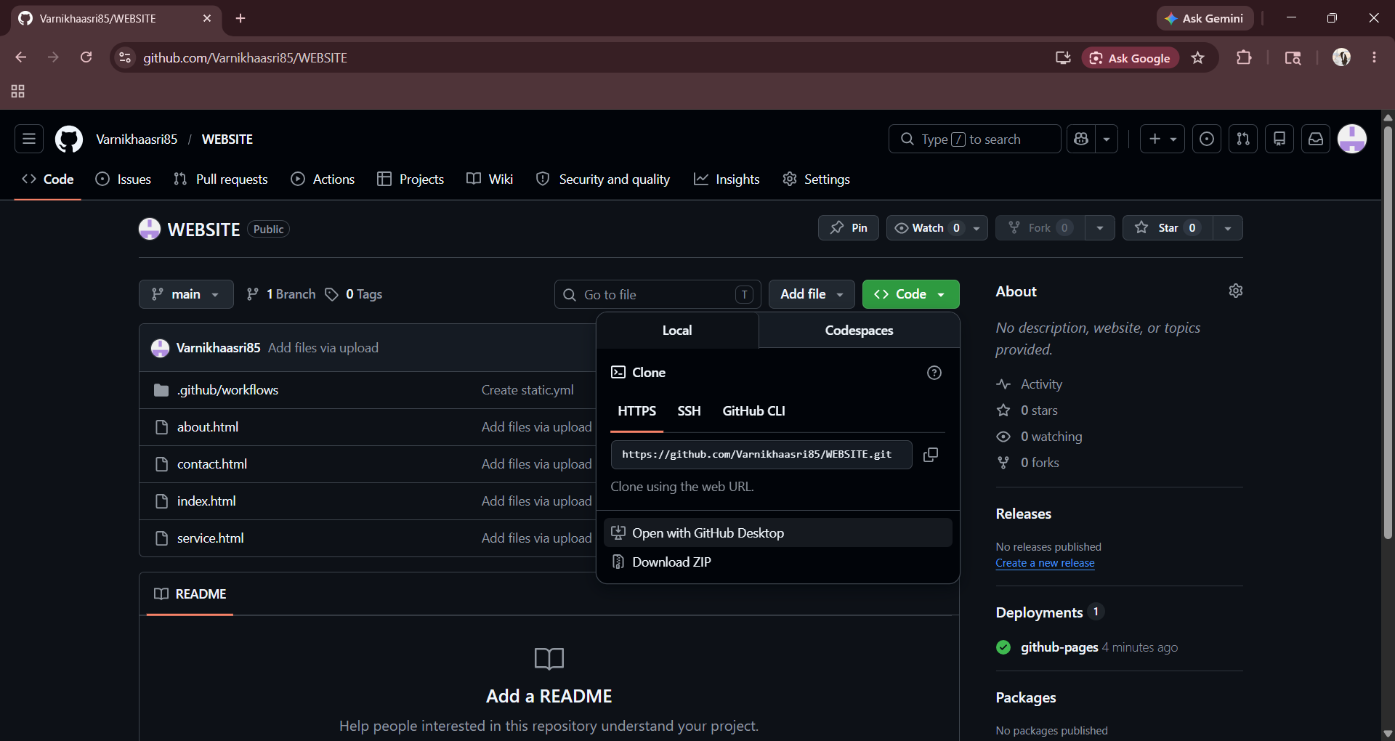
STEP 14:CLICK OPEN WITH GITHUB DESKTOP-->CLICK PUSH ORIGIN.

Slide 17
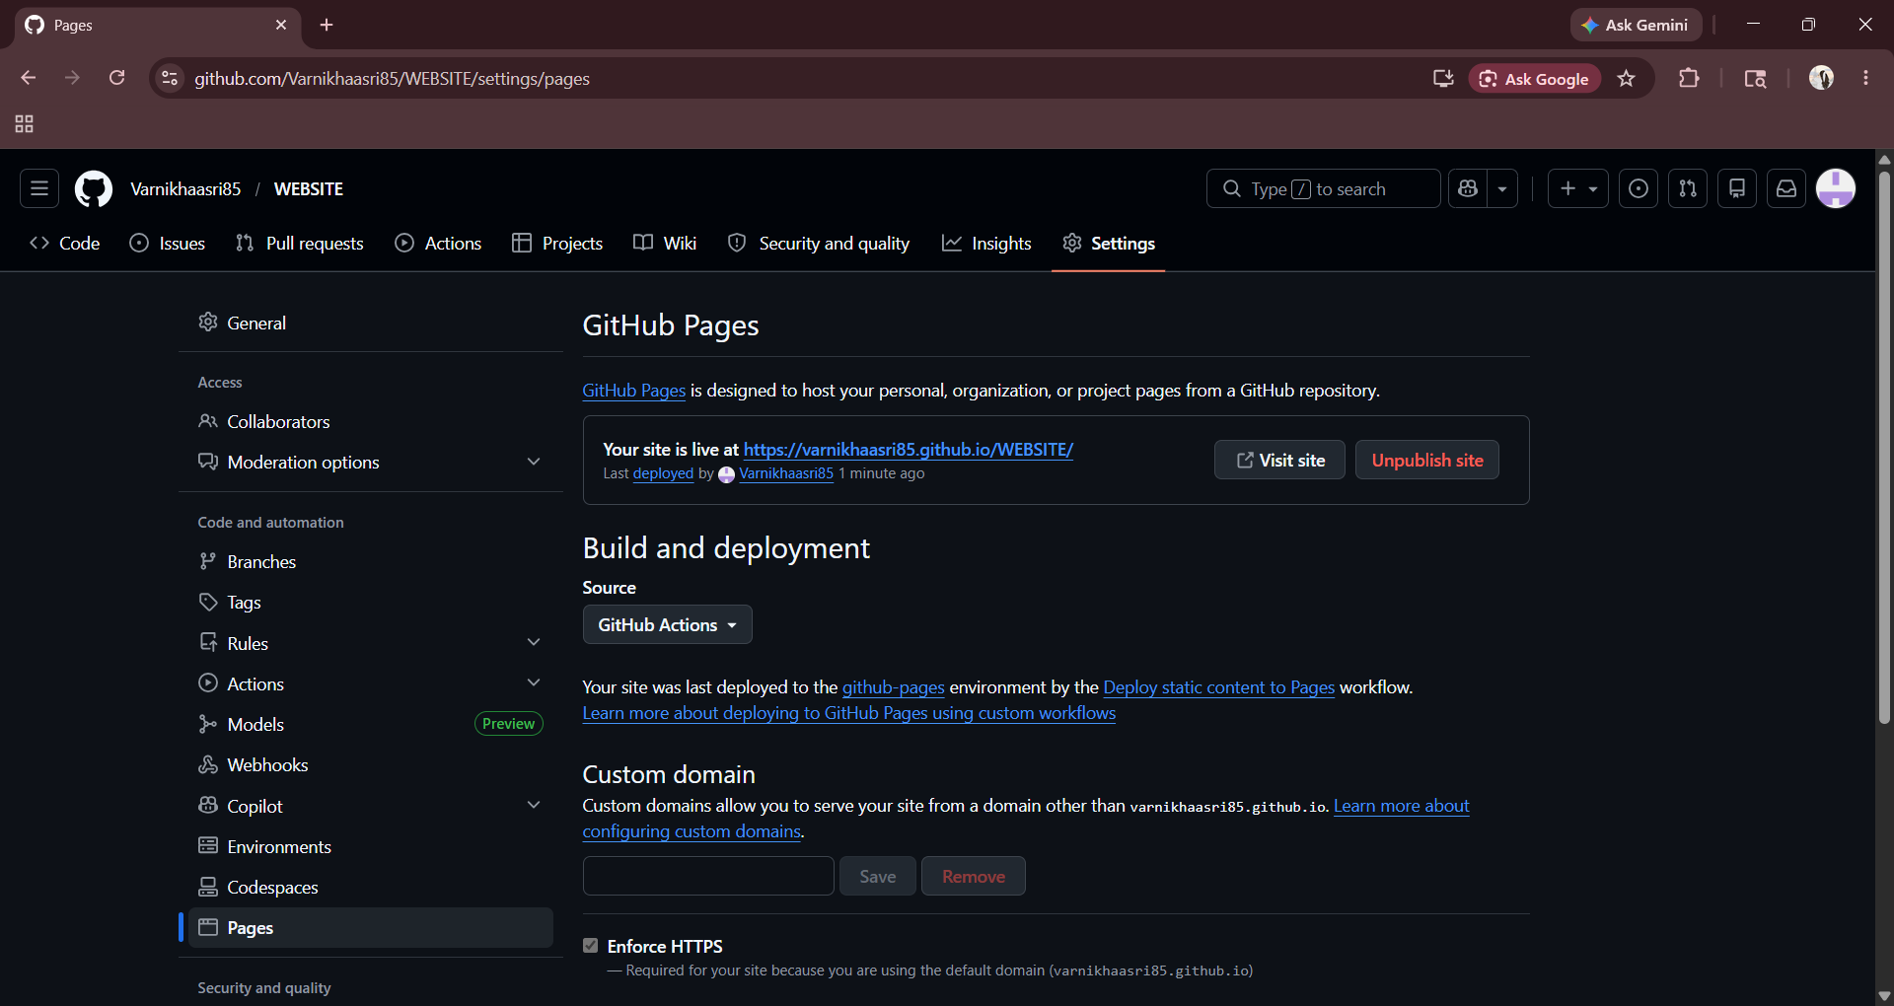
STEP 15:GO TO GITHUB CLICK SETTINGS THEN PAGES AND CLICK VIST SITE.

Slide 18
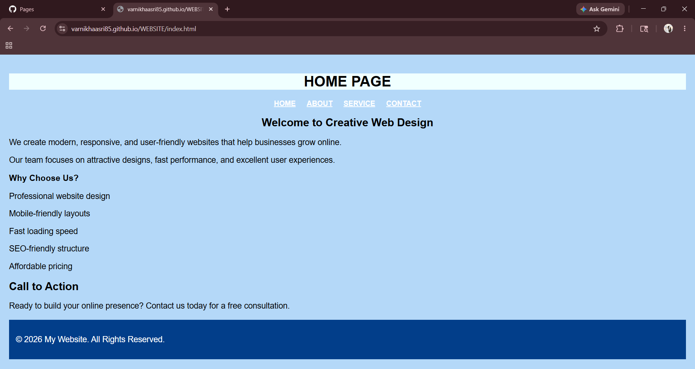
OUTPUT:
INDEX PAGE:

Slide 19
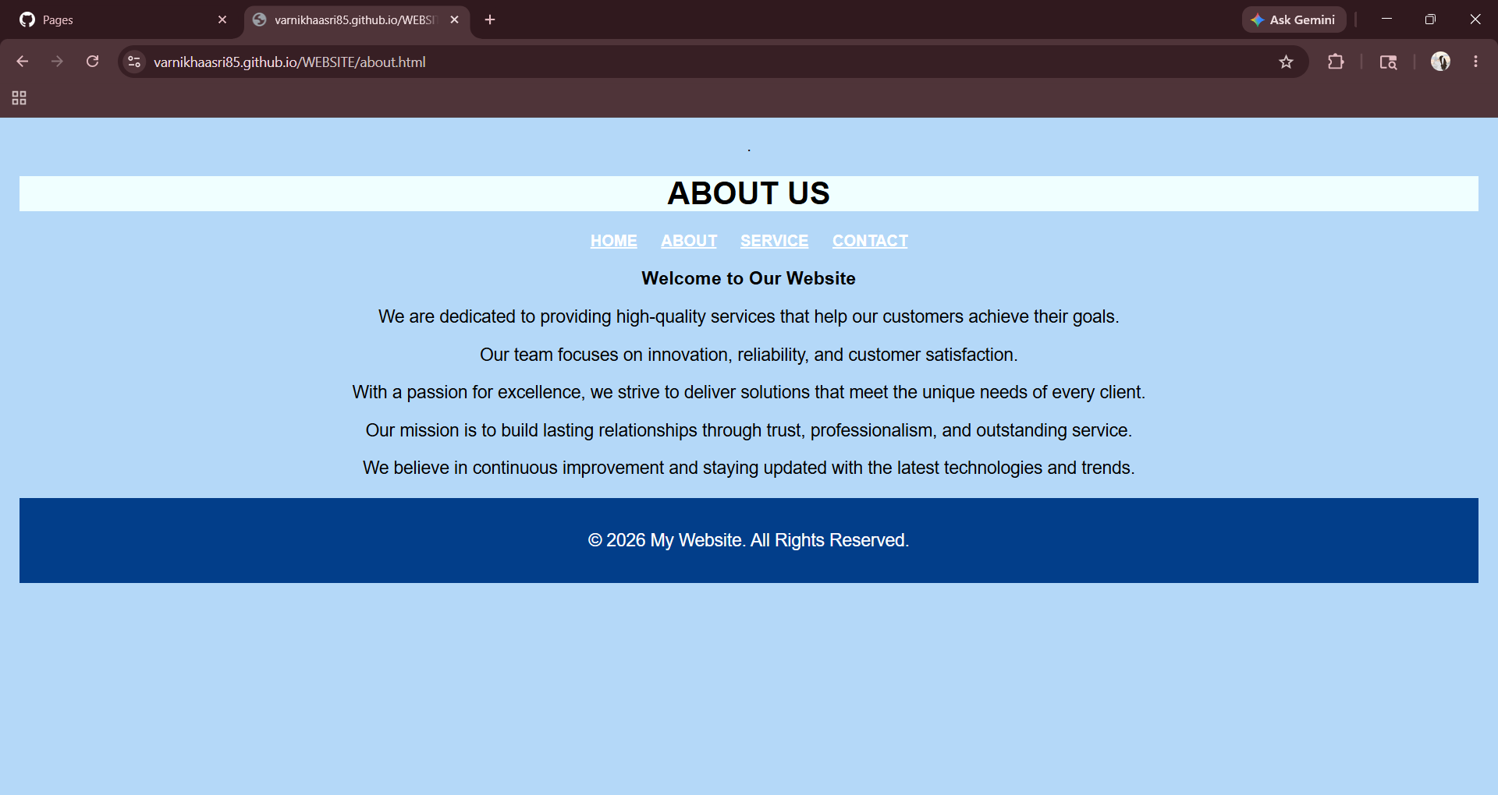
CONTENT PAGE:

Slide 20
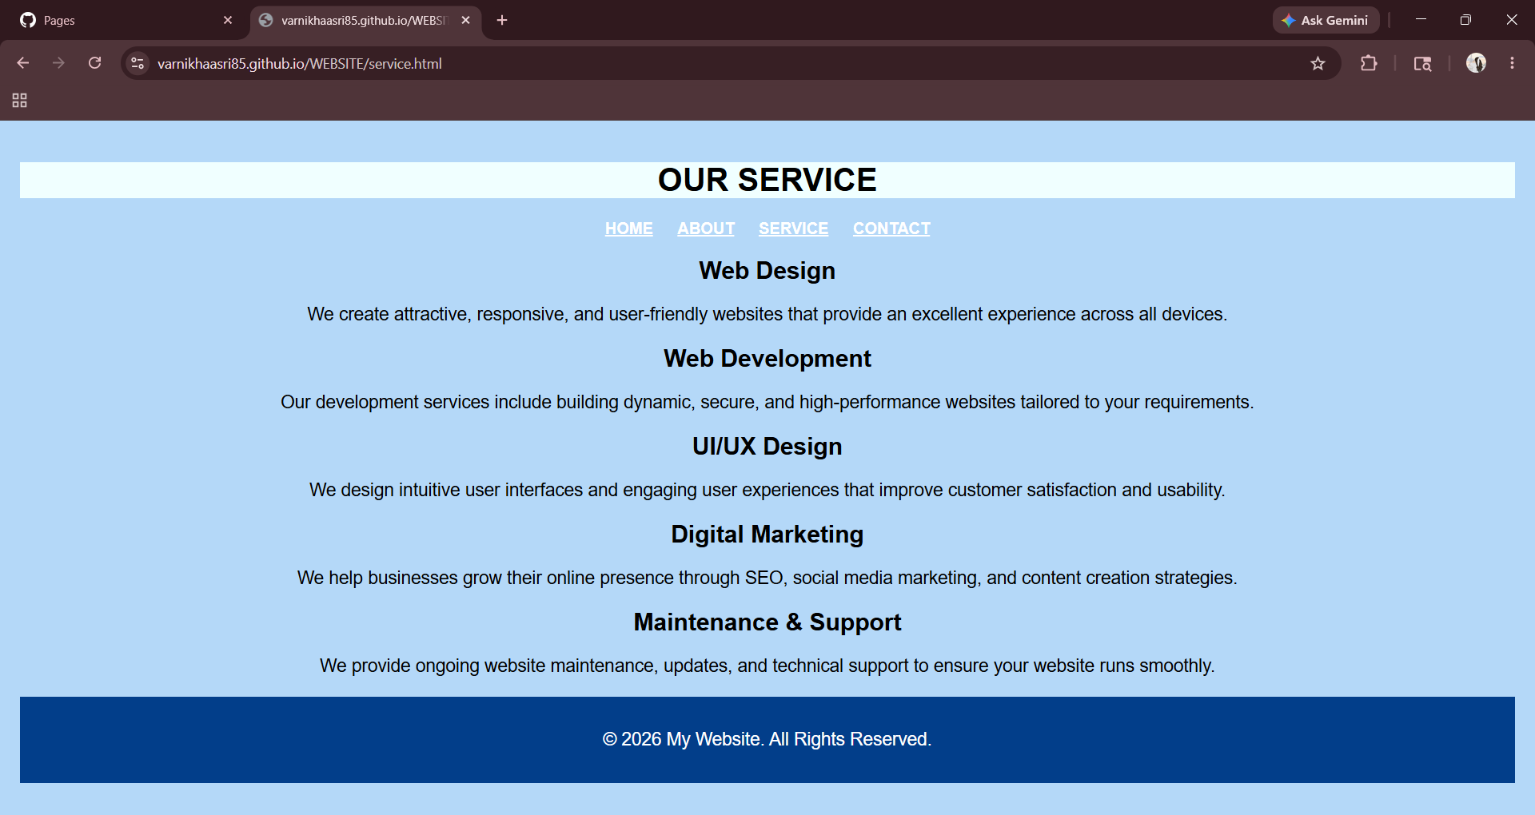
SERVICE PAGE:

Slide 21
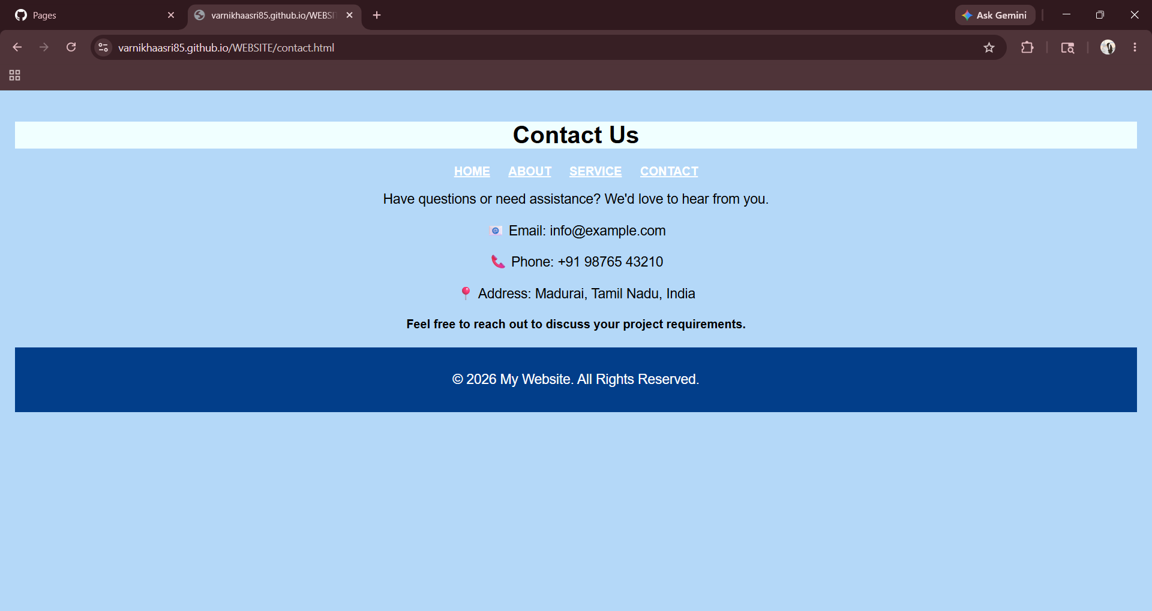
CONTACT PAGE:

